Slide 1

NATIONAL INSTITUTE OF TECHNOLOGY, ARUNACHALPRADESH
MINOR PROJECT 1
Department : Electronics & Communication Engineering
Topic: Reconfigurable All-Optical Multilogic Gate (XOR, AND, and OR)
Based on Cross-Phase Modulation in a Highly Nonlinear Fiber
SUPERVISOR
Dr. Sanjeev Kumar Metya
PRESENTER
Biswaditya Vikramjeet Borah (EC23B027)
Avinash Bhagat (EC23B002)

Slide 2
Why to Use Optical LOGIC GATES?
So far, we have done optical logic operations using SOAs (Semiconductor Optical Amplifiers) which require converting the signal from the optical domain to the electrical domain and then back to optical again, resulting in additional delay, complexity, and power consumption.
Optical logic gates are used because they offer several key advantages over traditional electronic logic gates:
1. Ultra-High Speed Operation
2. Signals Stay in the Optical Domain
3. Low Power Consumption
4. Parallel Processing Capability
5. Suitable for Future All-Optical Networks

Slide 3
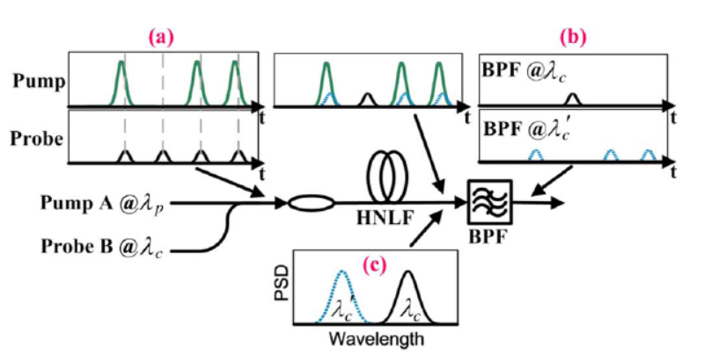
Working Principle Based on Cross-Phase Modulation (XPM):
When the high-power pump (A) and low-power probe (B) pass through the HNLF(Highly Non Linear fibre), the pump’s intensity imposes a phase shift on the probe through XPM under HNLF, resulting in a wavelength shift of Probe.
Using Band-Pass Filters (BPFs), the shifted or unshifted probe components are separated to generate logical outputs (XOR / AND / OR).
Pump and probe pulses enter HNLF.
(b) XPM causes the probe to shift only when pump = 1 → filtered as logic output.
(c) Spectrum shows original λc and XPM-shifted λ′c.

Slide 4
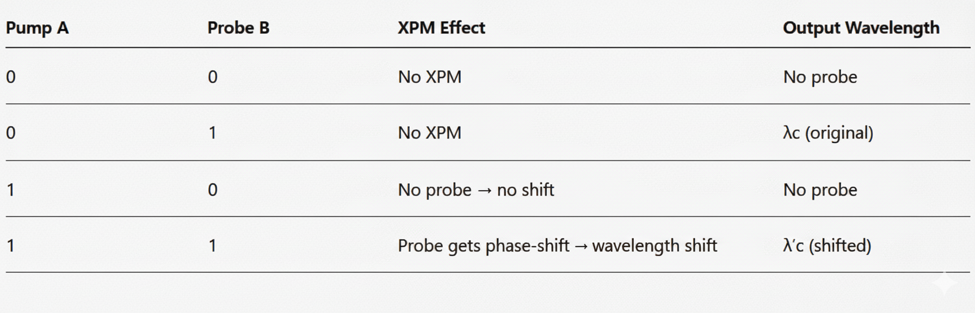
XPM Operation: Logic Table Representation

Slide 5

Mathematical Understanding of Cross Phase Modulation
This is the standard XPM formula for calculation of Wavelength Shift (Δλ)
These are values we have taken in according to our fiber
Length of fiber= 1km
α = 0.2 dB/km(Attenuation) → Effective Length ≈ 0.98 km
γ ≈ 9.6 /W/km (nonlinearity factor)
T Rise = 3.1 ps (typical in NRZ/RZ bitrates)
Pump peak power = 10 dBm = 0.01 W
Shifted Wavelength Results after applying the formula
λA=1555.2 nm Shifted λA’=1555.2 ± 0.078 nm
λB=1541.3 nm Shifted λB’=1541.3 ± 0.078 nm
Red Shift λ= λ+Δλ
Blue Shift λ= λ-Δλ
Reason behind Red and Blue shift
The pump power changes over time (rising edge + falling edge).
During the rising edge, wavelength shifts one way (red).
During the falling edge, wavelength shifts the opposite way (blue).

Slide 6
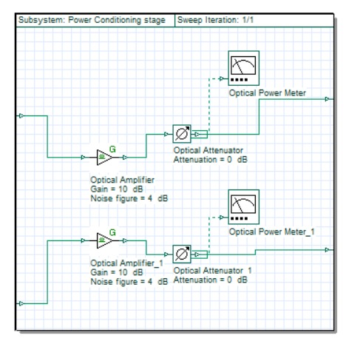
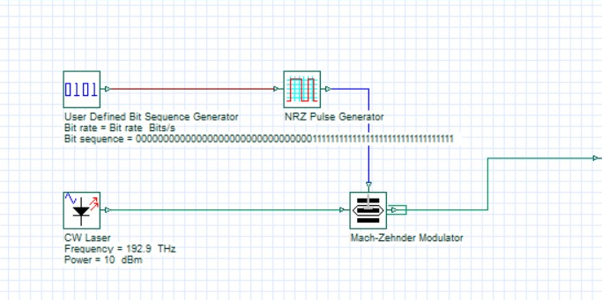
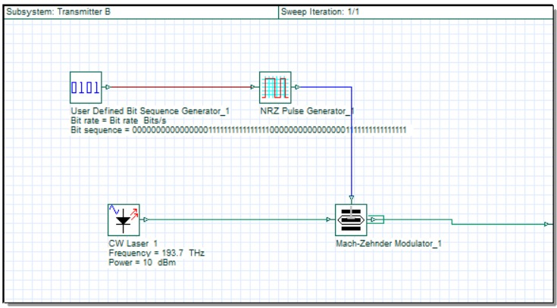
Experimental Setup in OPTISYSTEM
Transmitter A
Power Amplification Stage
Laser A
Laser A
Both Transmitter Set at Bit rate=10Gb/s
(Use of NRZ Pulse Generator)
Transmitter B
Laser B
Laser B

Slide 7
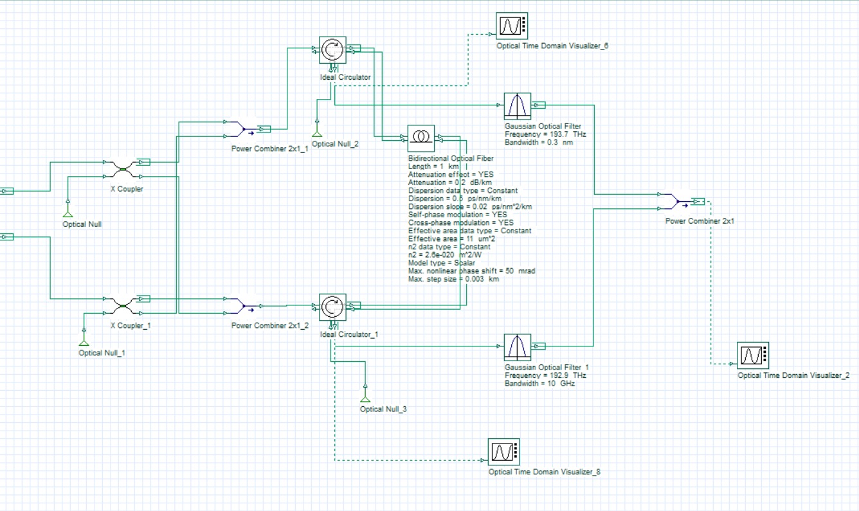
Circulator A
Band Pass Filter
BPF-1
A(pump)
B(Probe)
B(pump)
A(probe)
Laser A
95%
Output
5%
HNLF
XCouplers
Laser B
95%
5%
A(pump)
B(Probe)
B(pump)
A(probe)
Circulator B
Band Pass Filter
BPF-2

Slide 8
Table A — BPF-1 output (BPF-1 sees A as probe and B as pump)
• A = probe at λA=1555.2 nm and λA’=1555.2 ± 0.078 nm(BPF can be tuned to any one ±)
• If pump B = 1 (overlaps probe) XPM shifts A’s spectrum to λA′; if B = 0, A remains at λA.
• A = 1 means probe pulse present; A = 0 means probe pulse absent.
A(PROBE) | B (PUMP) | Spectral component at BPF-1 input | BPF-1 tuned to λA (passes original probe) → output | BPF-1 tuned to λA′ (passes XPM-shifted) → output
0 | 0 | No probe | 0 | 0
0 | 1 | No probe | 0 | 0
1 | 0 | Probe at λA | 1 | 0
1 | 1 | Probe shifted to λA′ | 0 | 1

Slide 9
Table B — BPF-2 output (BPF-2 sees B as probe and A as pump)
• B = probe at λB =1541.3 nm and Shifted λB’=1541.3 ± 0.078 nm(BPF can be tuned to any one ±)
• If pump A = 1, B’s probe is XPM-shifted to λB′; if A = 0, B remains at λB.
• B = 1 → probe pulse present; B = 0 → probe pulse absent
A (PUMP) | B(PROBE) | Spectral component at BPF-2 input | BPF-2 tuned to λB (original) → output | BPF-2 tuned to λB′ (shifted) → output
0 | 0 | No probe | 0 | 0
0 | 1 | Probe at λB | 1 | 0
1 | 0 | No probe | 0 | 0
1 | 1 | Probe shifted to λB′ | 0 | 1

Slide 10
WAVELENGTHS TO PASS TO GET LOGICAL OUTPUTS (AND, XOR, OR)
For AND Operation pass Shifted wavelengths of A & B
For XOR Operation pass Original wavelengths of A & B
For OR Operation pass Both Original + Shifted wavelengths of A & B as OR = AND+XOR
Logic Gate | BPF-1 | BPF-2 | Result
AND | λA′ | λB′ | Overlap → AB
XOR | λA | λB | Combine original probes → A ⊕ B
OR | λA, λA′ | λB, λB′ | Combine all → A +B

Slide 11
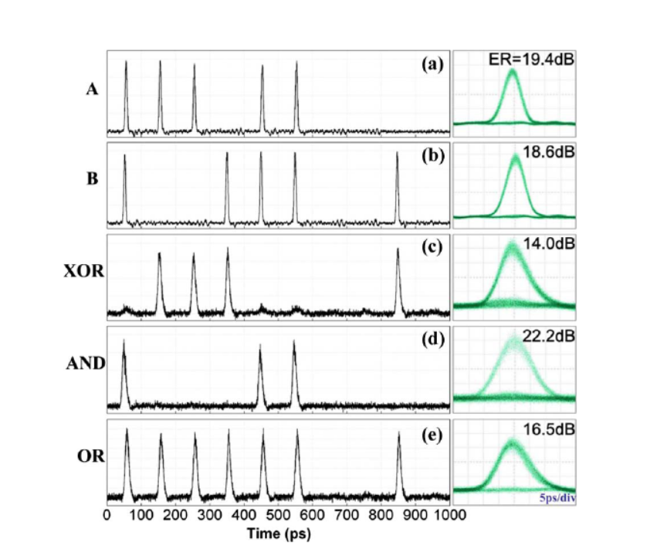
Experimental Result Waveform
(a) Input A,(b) Input B,
(c) XOR gate output,
(d) AND gate output, and (e) OR gate output

